Slide 1


Universidad de las Fuerzas Armadas ESPE Unidad de Educación a Distancia
Subject:
Web Application Development
NRC: 5450
Team 2 Members:
Espinoza Michael
Ramon Luis
Rojas Jaime
Guzman Diego

Slide 2
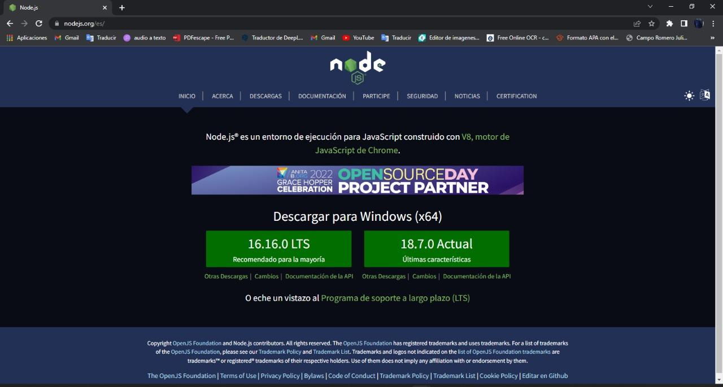
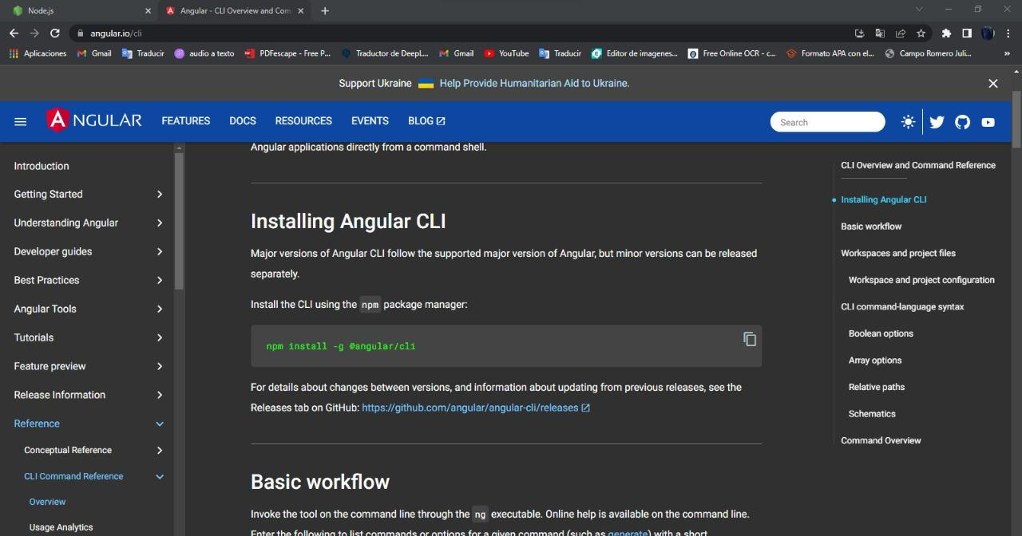
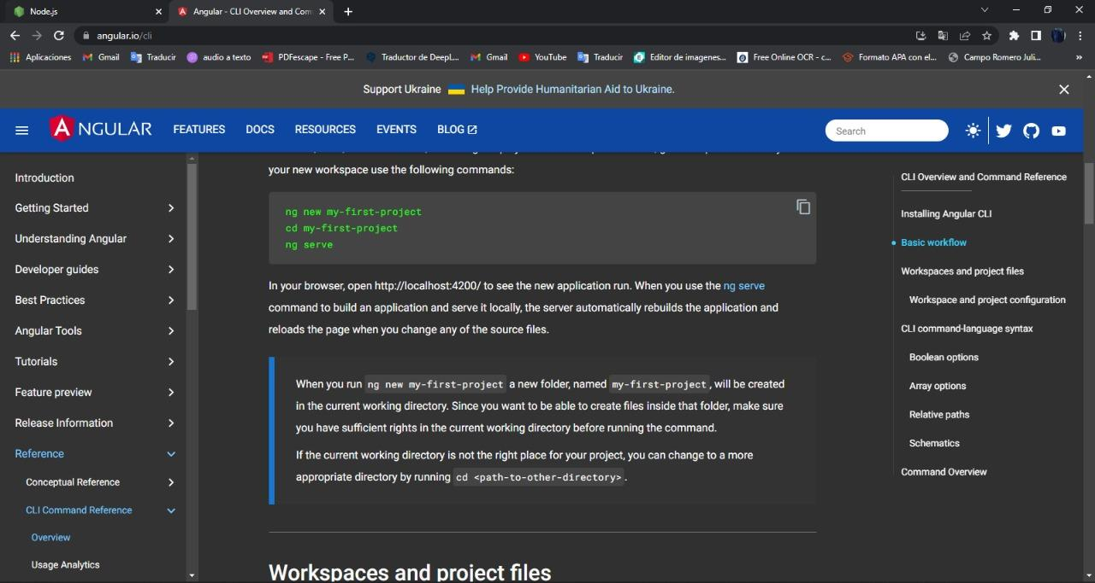
Install node js and angular

Slide 3
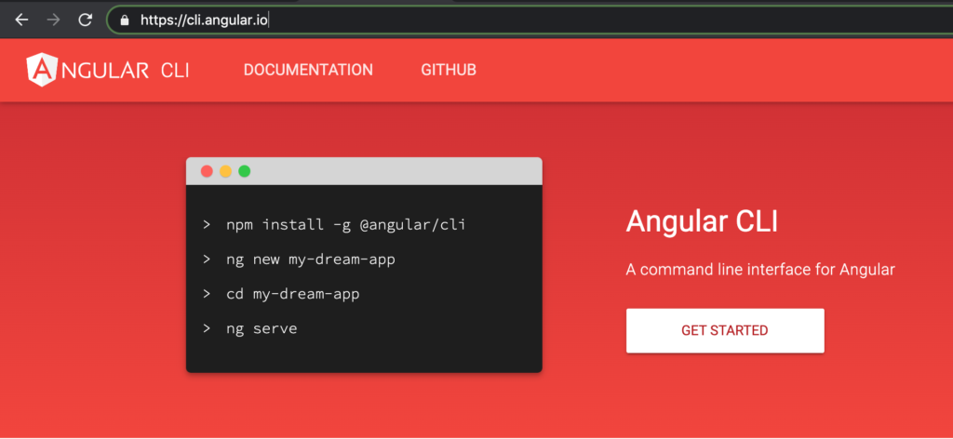
Angular create project

Slide 4
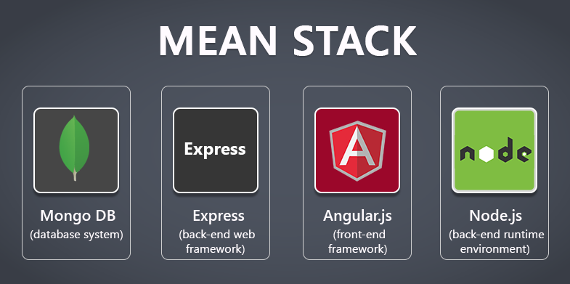
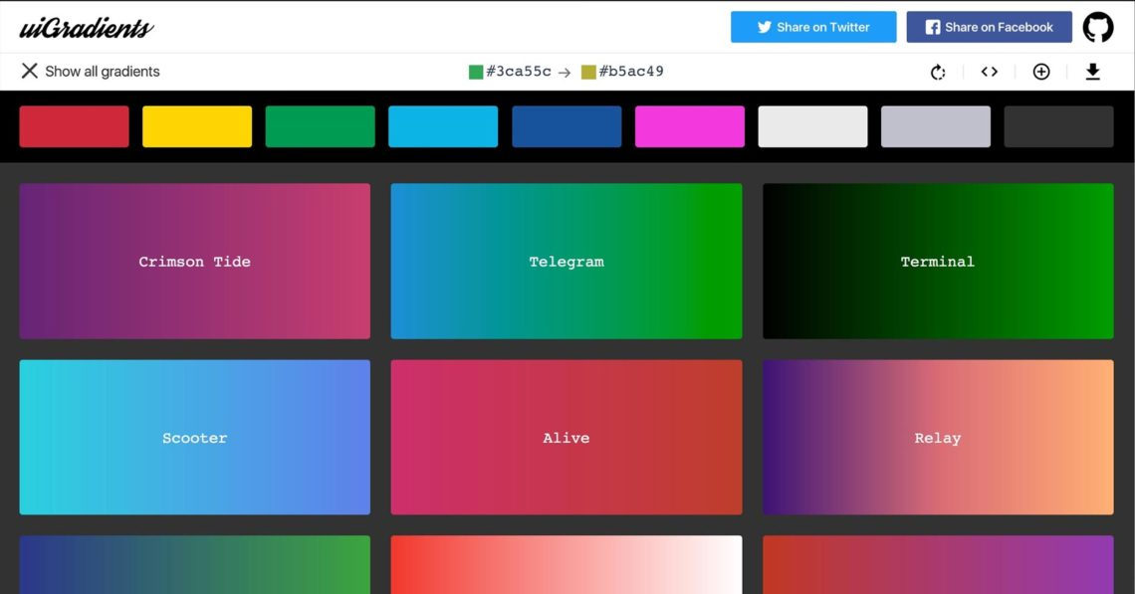
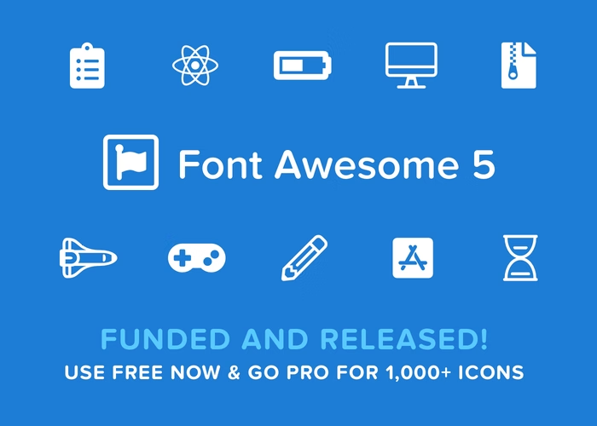

FRONTEND
We have created a CRUD using the Angular framework, in which we have created components, modules and services to communicate with our Backend, routing to move between the different components. We have also used Bootstrat5, FontAwesome, UIGradients and Toastr.

Slide 5
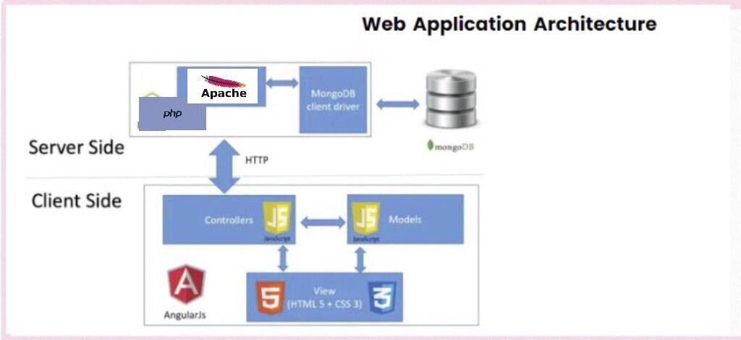

Slide 6
FRONTEND
The Client module is created with Angular, which created the insert product screen, list product in which you can edit and delete product.
For this we used the following libraries:
Forms, for the forms
Animations, for the Controller View
Core
Comoon
Cli, for the connection with the Backend
Jasmine, for the interface
Karma, for deployment

